Slide 1

Java course
-2-

Slide 2

2.
Oop`s and more
Let’s start with the real deal

Slide 3
What is OOP?
Java is a class-based object-oriented programming (OOP) language that is built around the concept of objects. OOP concepts (OOP) intend to improve code readability and reusability by defining how to structure a Java program efficiently.

Slide 4
What are OOP concepts in Java?
OOP concepts allow us to create specific interactions between Java objects.
They make it possible to reuse code without creating security risks or
making a Java program less readable.
Here are the four main principles in more detail.

Slide 5
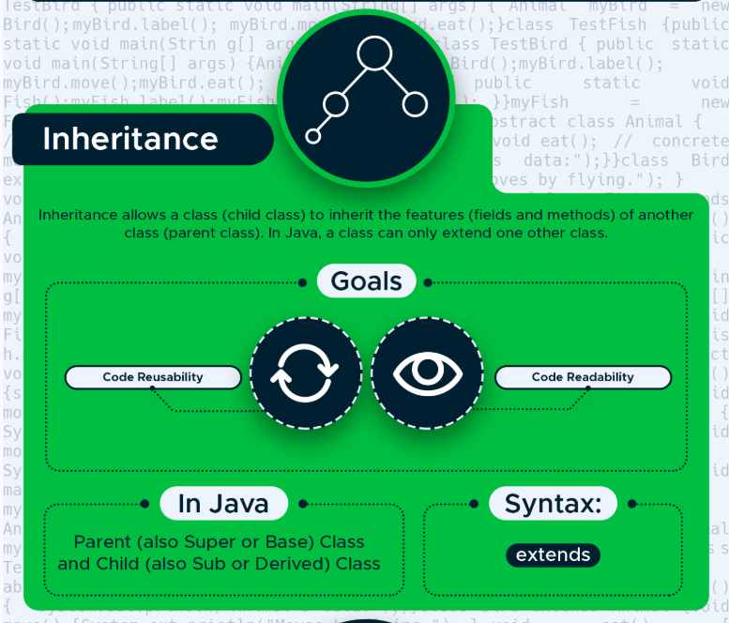

Slide 6
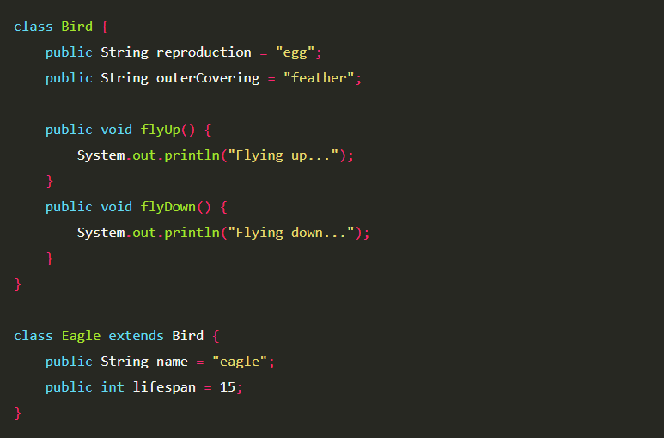

Slide 7
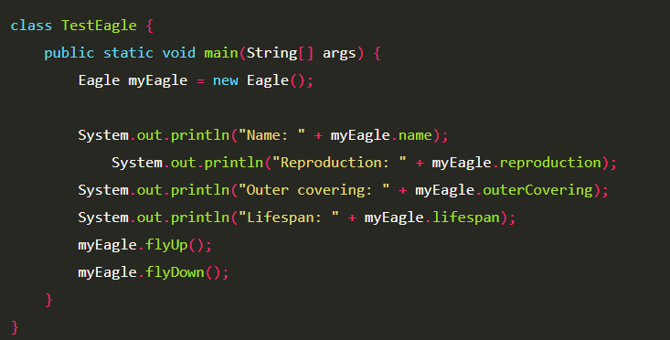

Slide 8
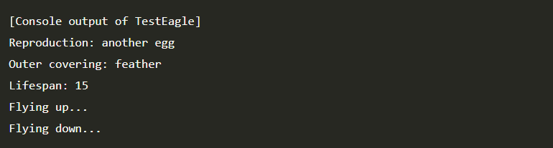

Slide 9
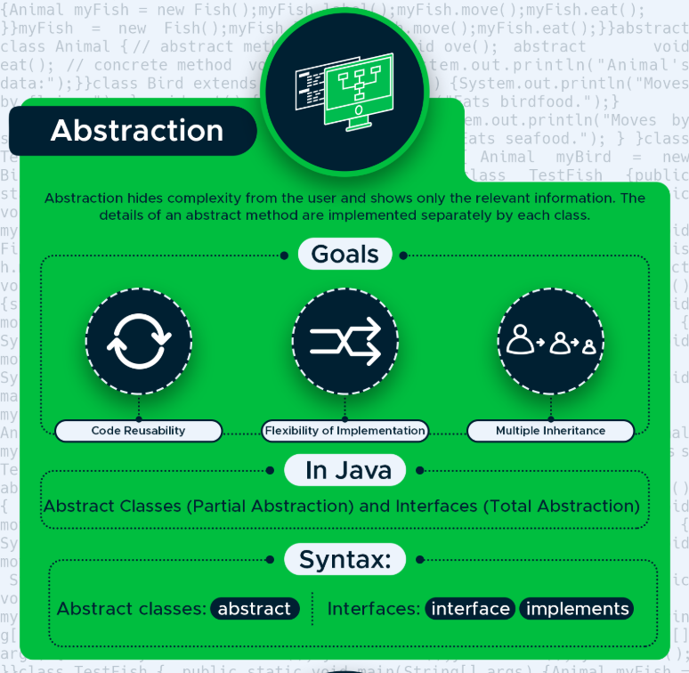

Slide 10
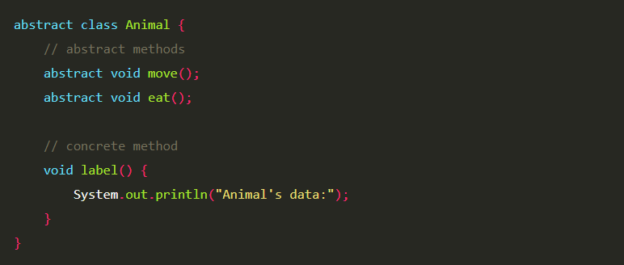

Slide 11
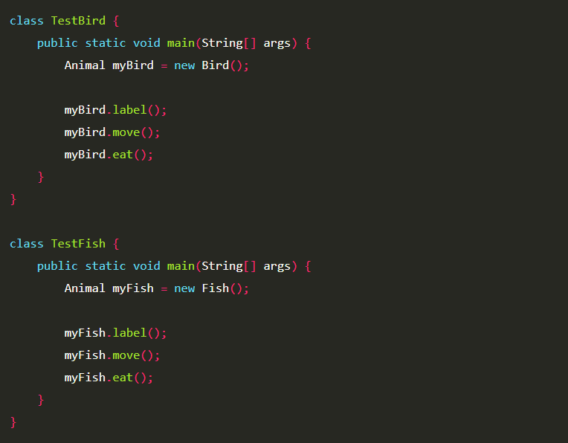

Slide 12
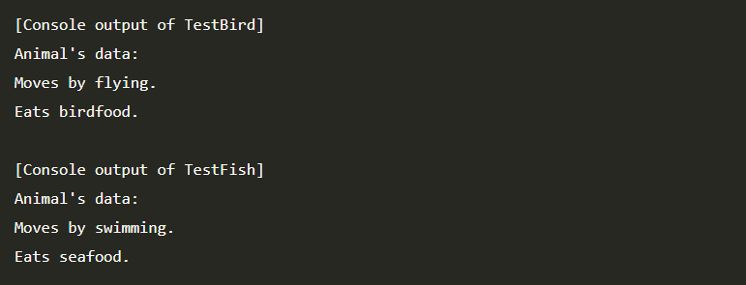

Slide 13
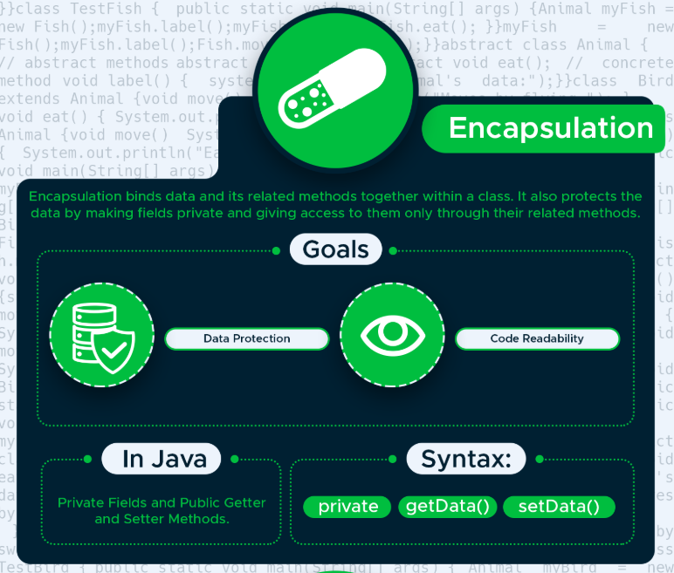

Slide 14
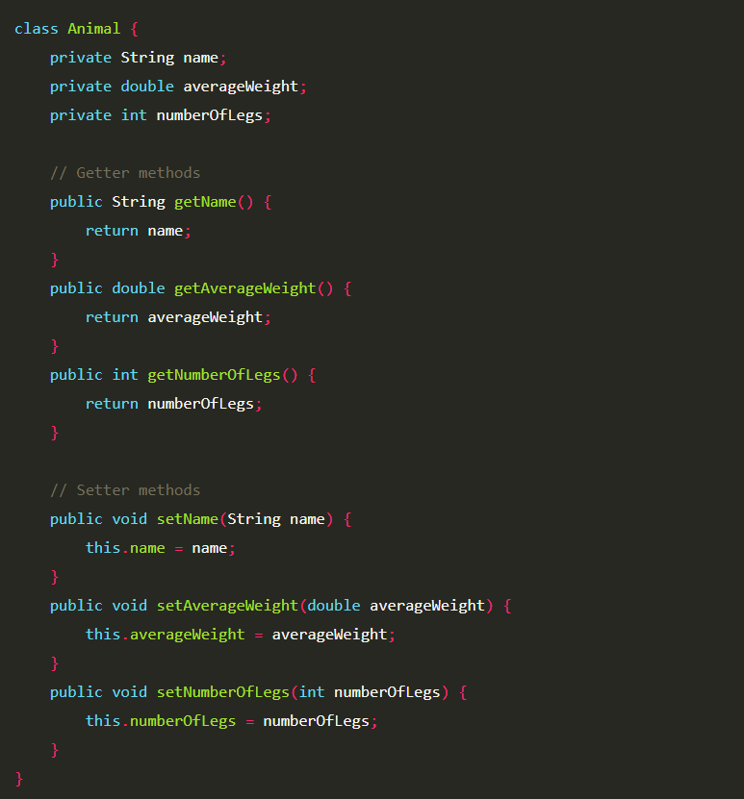

Slide 15
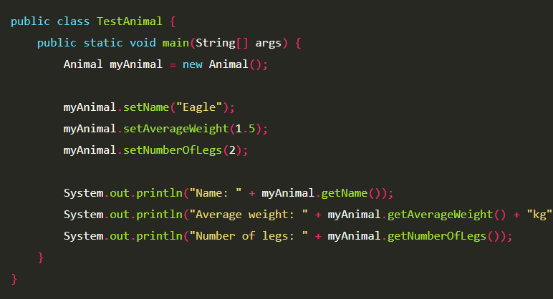

Slide 16
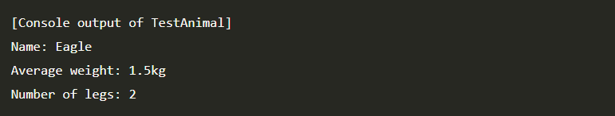

Slide 21
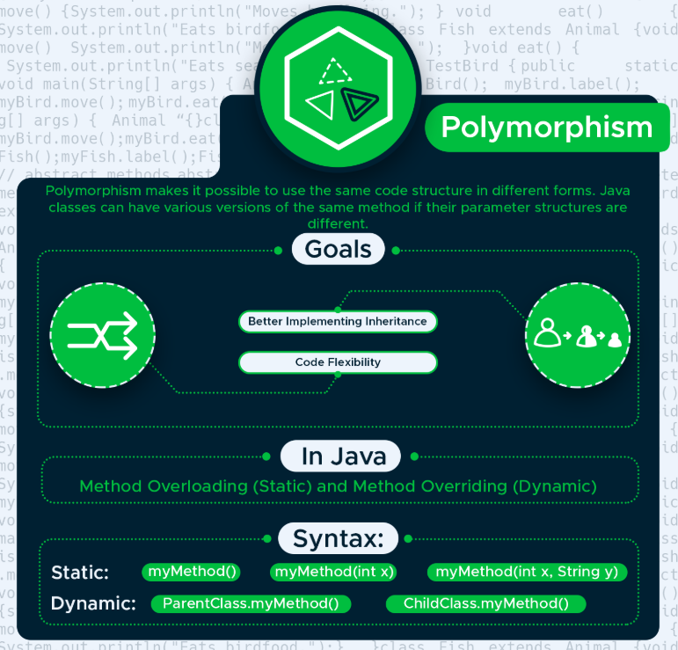

Slide 22
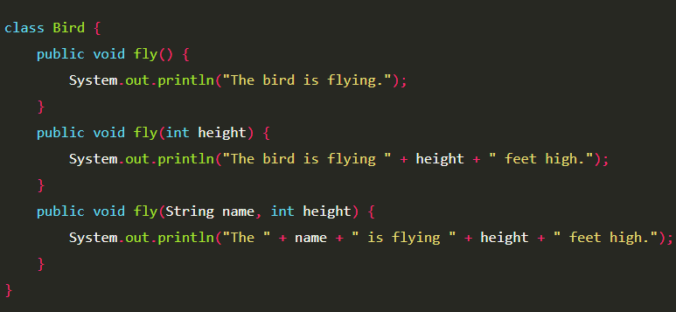

Slide 23
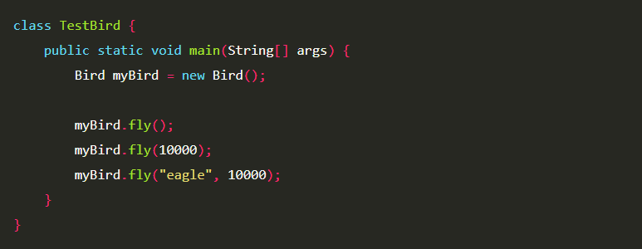

Slide 24
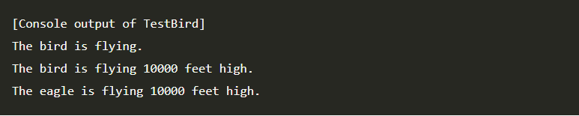

Slide 25
What is GIT
Git is a distributed version-control system for tracking changes in source code during
software development. It is designed for coordinating work among programmers,
but it can be used to track changes in any set of files. Its goals include speed, data integrity,
and support for distributed, non-linear workflows.

Slide 26
Creating a new repository
create a new directory, open it and perform a
git init
to create a new git repository.

Slide 27
Checkout a repository
create a working copy of a local repository by running the command
git clone /path/to/repository
when using a remote server, your command will be
git clone username@host:/path/to/repository

Slide 28
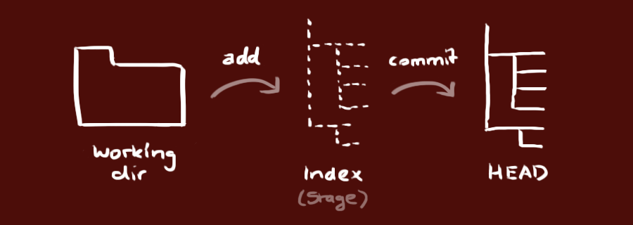
Workflow
Your local repository consists of three "trees" maintained by git.
The first one is your Working Directory which holds the actual files.
The second one is the Index which acts as a staging area
and finally the HEAD which points to the last commit you've made.

Slide 29
Add & commit
You can propose changes (add it to the Index) using
git add <filename>
git add *
This is the first step in the basic git workflow. To actually commit these changes use
git commit -m "Commit message"
Now the file is committed to the HEAD, but not in your remote repository yet.

Slide 30
Pushing changes
Your changes are now in the HEAD of your local working copy. To send
those changes to your remote repository, execute
git push origin master
Change master to whatever branch you want to push your changes to.
If you have not cloned an existing repository and want to connect your
repository to a remote server, you need to add it with
git remote add origin <server>
Now you are able to push your changes to the selected remote server

Slide 31
That`s it for today
Session review
-You learned OOP
-You know how to use OOP Principles
-You know how to use git
-You got ready for you`re first task
GOOD JOB! ☺
More details
@
https://github.com/VladCiocan/Suport-Curs-Java

